Slide 1
WIND ENERGY
MODULE 4

Slide 2
WIND ENERGY
Wind energy is produced by the movement of air (wind) and converted into power for human use. Wind has been used as a source of energy for more than a thousand years, but was replaced by fossil fuels for much of the 20th century. Today, wind is making a comeback as a source of electricity and power.
WIND ENERGY CONVERSION SYSTEM
An apparatus for converting the kinetic energy available in the wind to mechanical energy that can be used to power machinery (grain mills, water pumps, etc) and/or to operate an electrical generator.

Slide 3
Windmills
Windmills convert wind energy directly into mechanical energy for such tasks as milling grain or pumping water, which is usually the purpose of windmills you see on farms.
Windmill Mechanism
The spinning vanes of a windmill turn a camshaft, which is connected by gears and rods to the machinery that does the work. All power is directed into the work

Slide 4
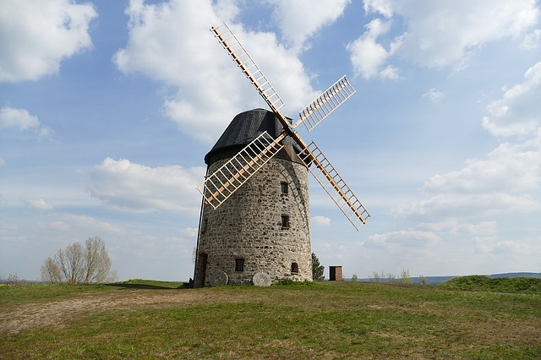

Slide 5
Wind Turbines
A wind turbine converts wind energy into electricity, which can then be used to power electrical equipment, stored in batteries or transmitted over power lines.
Wind Turbine Mechanism
The blades turn, convert the energy of wind into rotational energy, a form of mechanical energy, and this energy is in turn converted into electrical energy. A wind turbine has essentially the same parts as a simple electric motor, but it works in reverse: A motor uses electrical current to produce motion; a wind turbine uses motion to create electrical current.

Slide 6
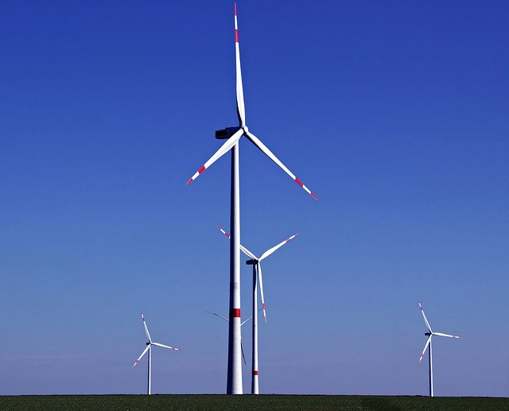

Slide 7
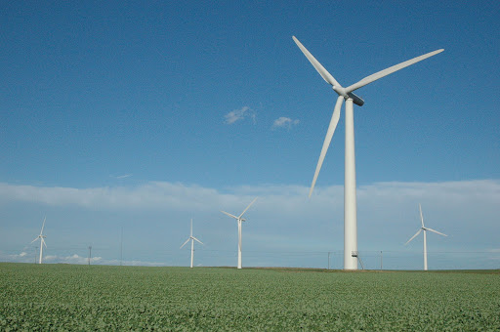
Wind Farms
In order to generate a large amount of electricity, wind turbines are often constructed in large groups called wind farms. Wind farms are made up of hundreds of turbines, spaced out over hundreds of acres.

Slide 8
The two main categories of wind turbines are
1. Vertical axis wind turbines and
2. Horizontal axis wind turbines.
A. HORIZONTAL AXIS MACHINES
A wind turbine in which the axis of the rotor's rotation is parallel to the wind stream and the ground. All grid-connected commercial wind turbines today are built with a propeller-type rotor on a horizontal axis. Horizontal-axis wind turbines (HAWT) have the main rotor shaft and electrical generator at the top of a tower, and may be pointed into or out of the wind. Small turbines are pointed by a simple wind vane, while large turbines generally use a wind sensor coupled with a servo motor.

Slide 9
Most have a gearbox, which turns the slow rotation of the blades into a quicker rotation that is more suitable to drive an electrical generator.
HAWTs can be subdivided into upwind wind turbines and downwind wind turbines compare with vertical-axis wind turbine.

Slide 10
Parts of the wind turbine
1. Blades
Most wind turbines have three blades. Very small turbines may use two blades for ease of construction and installation. Vibration intensity decreases with larger numbers of blades. Noise and wear are generally lower, and efficiency higher, with three instead of two blades.
Also, the cost of the turbine usually increases with the number of blades. Based on blade style classified as
The lifting style wind turbine blade. These are the most efficiently designed, especially for capturing energy of strong, fast winds.
The drag style wind turbine blade, most popularly used for water mills, as seen in the old Dutch windmills. The blades are flattened plates which catch the wind. These are poorly designed for capturing the energy of heightened winds.

Slide 15
2. Rotor
The rotor is designed aerodynamically to capture the maximum surface area of wind in order to spin the most ergonomically. The blades are lightweight, durable and corrosion-resistant material. The best materials are composites of fiberglass and reinforced plastic.
3. Gear box
A gear box magnifies or amplifies the energy output of the rotor. The gear box is situated directly between the rotor and the generator. A rotor rotates the generator (which is protected by a nacelle), as directed by the tail vane.

Slide 17
4. Generator
The generator produces electricity from the rotation of the rotor. Generators come in various sizes, relative to the output you wish to generate. The nacelle is the housing or enclosure that seals and protects the generator and gear box from the elements. It is easily removed for maintenance.
5. Yaw Mechanism
Yaw mechanism turns the rotor into the upwind direction as the wind direction changes. Electric motors and gear boxes are used to keep the turbine yawed against wind. This can be also used as controlling mechanism during high wind speeds.

Slide 18
6. Anemometers
Wind speed is the most important factor for determining the power content in the wind. The power content in the wind is directly proportional to cube of the wind velocity. Measuring wind speed is important for site selection. The device which is used for measuring wind speed is called anemometer. These are usually located on top of the nacelle.
Advantages
Higher wind speeds
Great efficiency
Disadvantages
➢ Angle of turbine is relevant
➢ Difficult access to generator for repairs

Slide 19
B. VERTICAL AXIS MACHINES
A type of wind turbine in which the axis of rotation is perpendicular to the wind stream and the ground. A vertical-axis wind turbine’s (VAWTs) main rotor shaft is set vertically and the main components are located at the base of the turbine. VAWTs work somewhat like a classical water wheel in which water arrives at a right angle (perpendicular) to the rotational axis (shaft) of the water wheel. Vertical-axis wind turbines fall into two major categories: Darrieus turbines (Lift Device) and Savonius turbines (Drag Device). Neither type is in wide use today.

Slide 21
The basic theoretical advantages of a vertical axis machine are:
➢ The generator, gearbox etc. may be placed on the ground, and a tower is not essential for the machine
➢ A yaw mechanism isn't needed to turn the rotor against the wind
The basic disadvantages are:
➢ Wind speeds are very low close to ground level, so although a tower isn't essential, the wind speeds will be very low on the lower part of the rotor
➢ The overall efficiency of the vertical axis machines is not impressive

Slide 22
The machine is not self-starting, i.e. a Darrieus machine needs a "push" before it will start. This is only a minor inconvenience for a grid-connected turbine, however, since the generator may be used as a motor drawing current from the grid to to start the machine
The machine may need guy wires to hold it up, but guy wires are impractical in heavily farmed areas
Replacing the main bearing for the rotor necessitates removing the rotor on both a horizontal and a vertical axis machine. In the case of the latter, it means tearing the whole machine down.

Slide 23

POWER COEFFICIENT, BETZ COEFFICIENT BY MOMENTUM THEORY
Available Wind Energy
The kinetic energy of a stream of air:
E = $\frac{1}{2}$ m$V^{2}$
Available Wind Power
Power is the energy per unit time and expressed
P = dE/dt
P = $\frac{1}{2}{ ρ}_{a}$ $A_{T} V^{3}$
Power Co-efficient
The efficiency is the ratio of actual power developed by wind turbine rotor to the available wind
power. It is also defined as power coefficient and expressed as

Slide 24

$C_{p}$ = $\frac{P_{T}}{\frac{1}{2}{ ρ}_{a} A_{T} V^{3}}$
The power coefficient or the power picked up by the wind turbine rotor is influenced by many factors:
- profile of the rotor blade
- number of blades
blade arrangement
Torque Co-efficient
The thrust force developed by the rotor is
F = $\frac{1}{2}{ ρ}_{a}$ $A_{T} V^{2}$
The rotor torque is
T = $\frac{1}{2}{ ρ}_{a}$ $A_{T} V^{2}$ R

Slide 25

The torque developed by the rotor shaft is less than the maximum theoretical torque and given in terms of coefficient of torque
$C_{T}$ = $\frac{T}{\frac{1}{2}{ ρ}_{a} A_{T} V^{2}}$
Tip Speed Ratio
$V_{rω}$ = $\frac{ωR}{V}$ = $\frac{2πNR}{V}$
Where,
R = radius of the rotor
$ω$= Angular velocity
N = Rotor rotational speed, rpm
Also, it can be shown that power coefficient and torque coefficient is related by relative speed:
$\frac{C_{p}}{C_{T}}$ = $V_{rω}$ = $\frac{ωR}{V}$

Slide 26
Solidity
Solidity is the ratio of total rotor plan form area to total swept area.
Solidity = 3a/A

Slide 27

Betz’ Limit
All wind power cannot be captured by rotor or air would be completely still behind rotor and not allow more wind to pass through. Betz’ law States the theoretical limit for the conversion of wind energy in wind turbine. According to this law maximum possible wind turbine efficiency is less than
59.3 %
$C_{p,max}$ = $\frac{16}{27}$ = 0.5926

Slide 28
BETZ COEFFICIENT BY MOMENTUM THEORY
This analysis uses the following assumptions:

Slide 29
Figure: Actuator model of a wind turbine: U=Mean air velocity; 1,2,3,4, indicate locations

Slide 38
THANK YOU

